Slide 1
How to use this template.
Template made by Jenni Rinker: Projects with Jenni.
You are welcome to change the slide design.
See comments in green for meta-commentary.
Update the filename, e.g., “2025.02.20_jenni_weekly.pptx” and upload it to Teams.
Any text with square brackets “[]” should be deleted or updated with relevant information. Comments should also be deleted.
If you do not have a clear list of topics you want to discuss with the supervisors, cancel the weekly meeting.
Let me know if you have suggestions for improvement on this template.☺

Slide 2
[Project title]
[Student name(s)]
Weekly status meeting

Slide 3
Agenda
The first order of business in the meeting should be overviewing/approving the agenda. This is the chance for your supervisor to jump in and say ”oh hey! we need to talk about this administrative thing! better add it to the agenda.”
[Item 1]
[Item 2]
(etc.)
Agenda items should be clear and with a definable outcome that you want from your supervisor. E.g., an agenda item called “Results” is vague! Results for what? And what do you want from your supervisor with “Results”? Do you want them to verify that your interpretation is correct? Do you have something in your results you don’t understand and need help interpreting?
In general, don’t just present something to show that you ”did work” this week. Be clear in what feedback/support you want from your supervisor on each agenda item.

Slide 4
Agenda (example)
Present 3 relevant papers from literature review
Align on/approve simulation methodology for Subcase A
Review/approve Figure 1 for thesis
Spar on results interpretation for Figure 2
Review/approve Gantt chart for remainder of project
These agenda items are specific, and we can guess that the author has a clear idea in each item what they are hoping for from the student. 10/10, no notes.

Slide 5
Paper 1 from literature review (example)
Paper: “How to make up paper titles in 10 days”
Author: Jenni Rinker
Key relevant conclusions by authors:
  A paper title can be made up in 30 seconds (or less)
Key relevant interpretations by me:
  Rinker is not good at coming up with fake papers
Key limitations:
  They just make it up
How we can use this:
  Provides evidence that not just everyone can make up papers.
In the beginning of your project, it’s good to take time in your supervision meetings to review papers as you work on your literature survey. Your supervisor may not be up to date on recent publications! And if you spar on the papers together, you benefit from their experience and their better understanding of the research’s context.
Here is one way that you could briefly present a paper. Note that your personal literature survey (see website for more details) should have MUCH more detail on the paper. Your focus in the presentation is presenting the key relevance for YOUR research.

Slide 6

Approve simulation methodology (example)
In Subcase A, we want to show that TbFA loads follow thrust trend.
Proposed methodology:
  Simulate HAWC2 for 5 minutes at different mean wind speeds, no turbulence
  Calculate mean of TbFA
  Plot mean(TbFA) versus mean wind speed
  Add theoretical line (equation at right)
Hypothesis: the simulation results and the theoretical line will match.
Is this proposed methodology and hypothesis correct?
Try to reduce text on your slides. Sentence fragments instead of full sentences are fine.
This is a nice slide because it (a) reminds the supervisor of the motivation, (b) presents the methodology, (c) gives a hypothesis of what is expected to occur, and (d) makes it clear from the supervisor what you want.
$$TbFA≈Thrust ∗HH$$

Slide 7
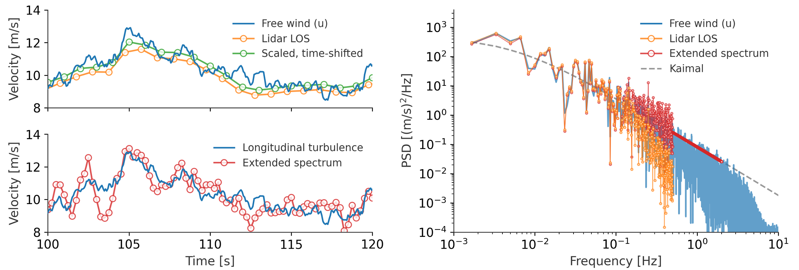
Review/approve Figure 1 for thesis (example)
Figure objectives:
  Show phase shifting in frequency domain correctly shifts in time domain
  Show that spectral extension correctly adds (1) 5/3 roll-off in spectra and (2) high-frequency content in time domain
Feedback on figure?
Proposed caption:
Comparison of free wind, LOS measurement, and constraining time series at Beam 4 for the DTU 10 MW and a mean wind speed of 11.4 m/s. The orange lines indicate the raw lidar data, the green lines represent the lidar signal after it has been scaled and time-shifted, and the red lines demonstrate a final constraining time series with the spectral correction and extended power spectrum.
It’s nice to spar on figures/captions before putting them in your thesis. Here is a way that you can efficiently present a figure, a caption, and the intent of the figure to your supervisor.
Figure and caption taken from https://iopscience.iop.org/article/10.1088/1742-6596/2265/3/032011/pdf, Figure 1.

Slide 8
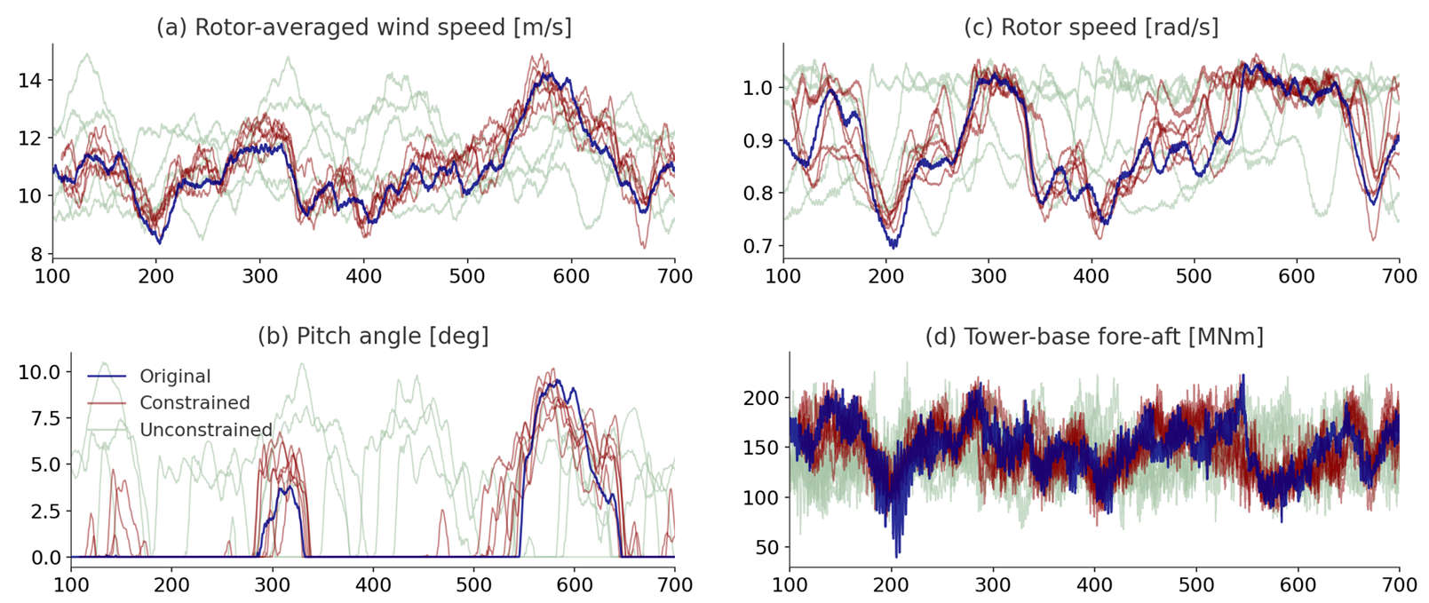
Spar on results for Figure 2 (example)
Analysis objective:
  Show that constrained results follow significantly better than unconstrained.
Interpretation:
  The red (constrained) lines are much closer to the blue (unconstrained).
  I.e., the method works.
But I don’t understand why we have oscillations in TbFA?
^^ Current results for Figure 2.
Here is an example of how you could spar on in-progress work. It’s
good to remind the supervisor of the analysis objective (we can forget
from week to week!), and putting your interpretation in writing helps
with clarity of thought. Don’t be afraid to highlight things you don’t
know and ask for feedback! (Bonus points if you make a hypothesis
first!)
Figure and caption taken from https://iopscience.iop.org/article/10.1088/1742-6596/2265/3/032011/pdf, Figure 3.

